Slide 1
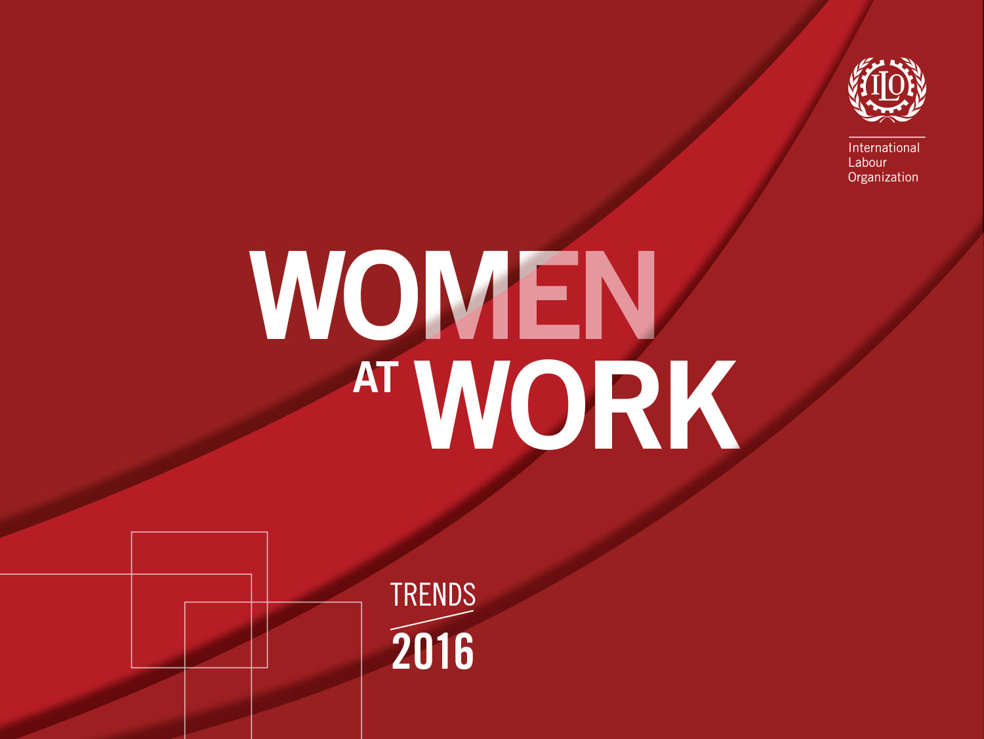
Mariko Ouchi
ILO-Budapest Office

Slide 2

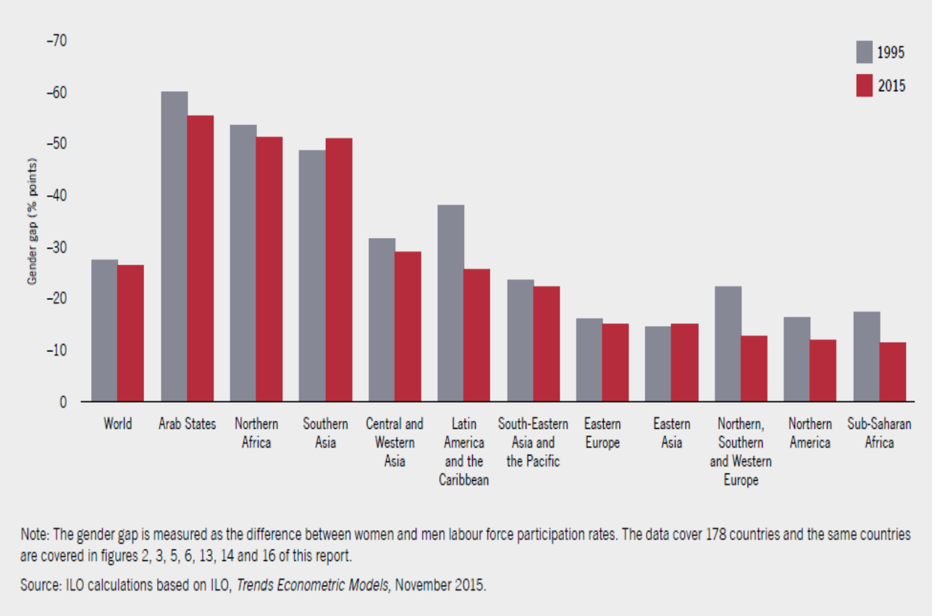
Gender gaps in labour force participation rates by region
Eastern Europe

Slide 3
Employment status by sex across regions, 2015
Eastern Europe

Slide 4
Employment by sector and sex
Eastern Europe and Central Asia

Slide 5
Informal employment as % of non-agricultural employment
Eastern Europe and Central Asia

Slide 6
Person working less than 35 hours per week, by status of employment
Eastern Europe

Slide 7
Percentage of women legally and effectively covered by maternity leave and benefits
Eastern Europe and Central Asia

Slide 8
Maternity leave duration and amount of cash benefits, 2015
Eastern Europe and Central Asia

Slide 9
Women at Work
Recent trends in Eastern Europe in global comparison - Summary
Labour force participation rate in EE:
- Gender gap is relatively low but not much progress observed
in the past 20 years;
Employment trends in EE:
- Mostly formalized for both women and men;
- Lower informal employment for women and
- Higher concentration of female employment in service sector;
- Relatively high percentage of women working in full time in EE.
However…
- Less women working in full time than men and
- about ¼ of self-employed women in EE working with shorter hours;
Maternity protection in EE and Central Asia:
  - Relatively high legal and effective coverage of maternity leave and
  benefits which is in compliance with C183

Slide 10
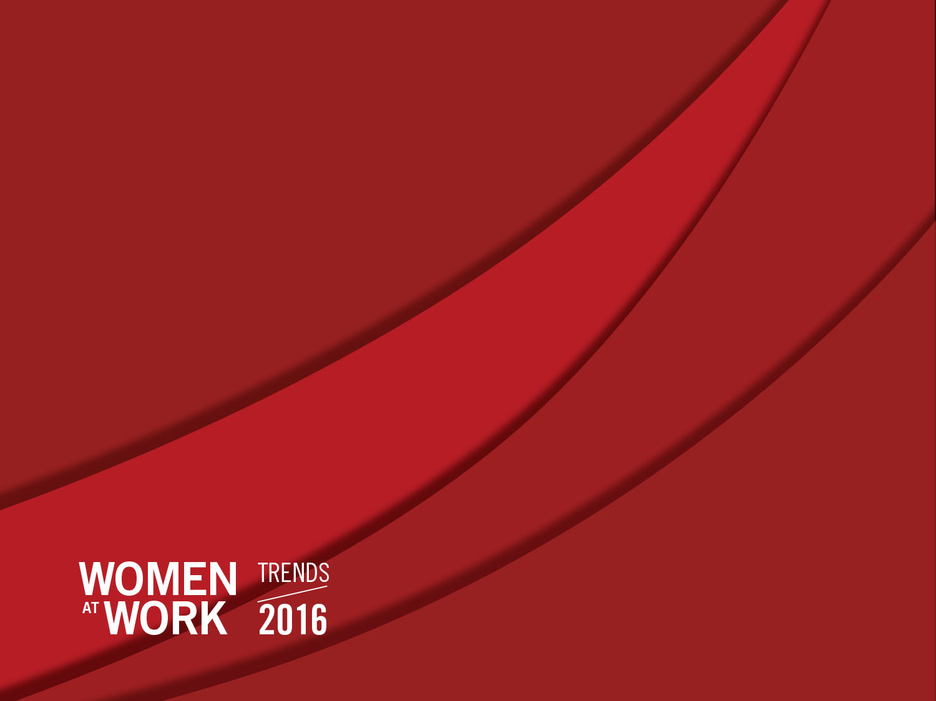
Thank you very much for your attention!

