Slide 1
50 Company
A Dutch Best Practice

Slide 2
Anne-Marije Buckens
founder / owner 50 Company
expert in the field of aging workforce and sustainable work
annemarije@50company.nl

Slide 3
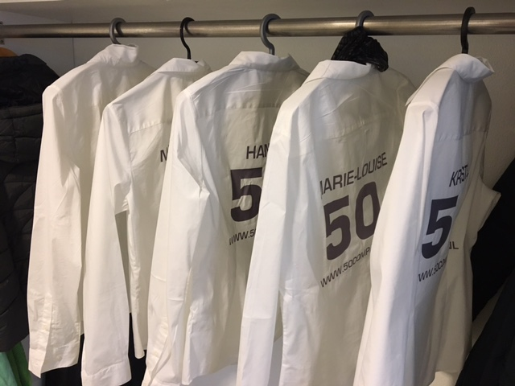
About 50 Company
Arnhem (The Netherlands)
Since 2011
Job Coaches and Recruiters
Network organisation
Helped hundreds of people over 50 back to work

Slide 4
50 Company
career agency for
people over 50
career advice
outplacement
workshops
network
mediation
recruitment
aging workforce
sustainable labour participation
internationa labour market projects

Slide 5
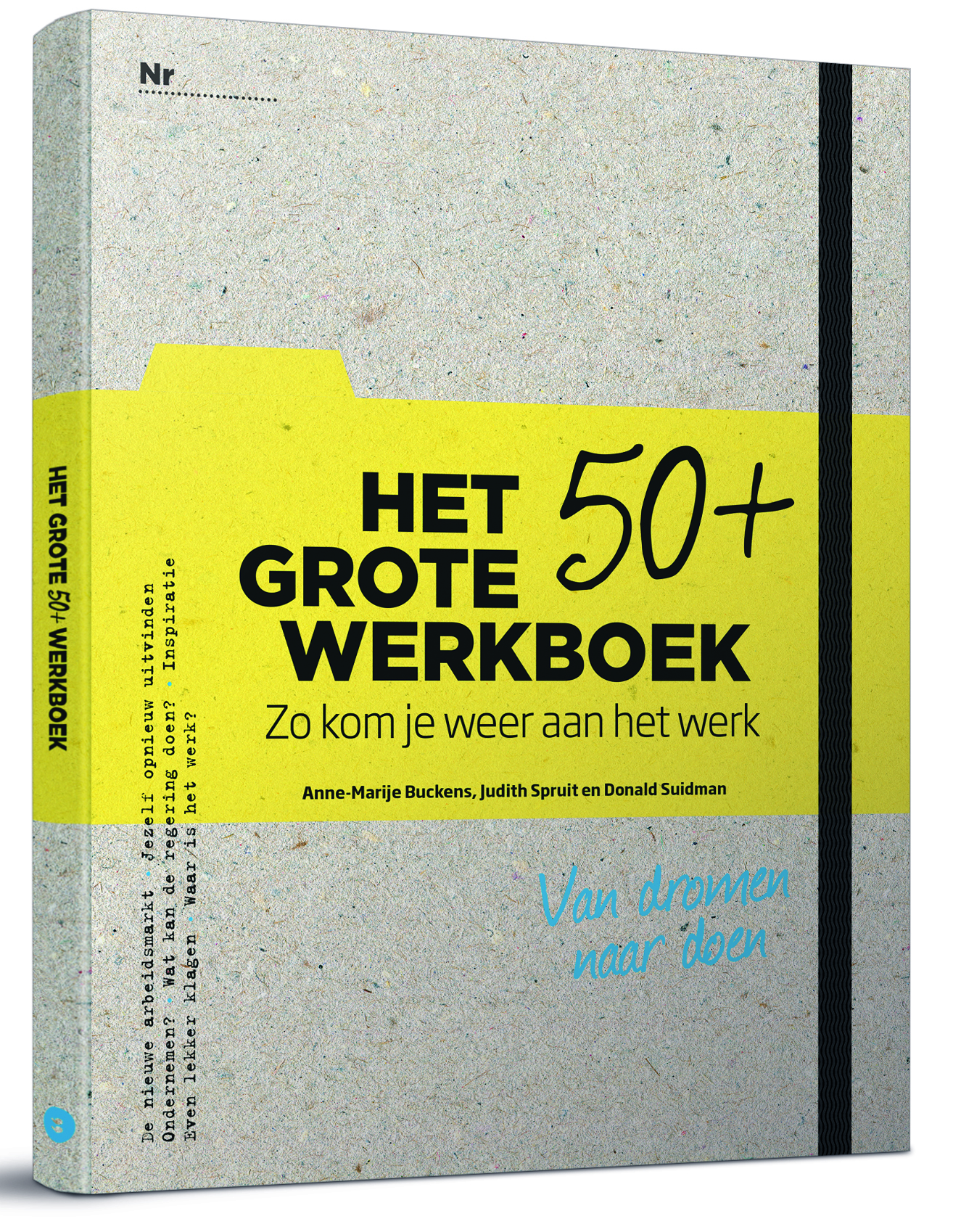
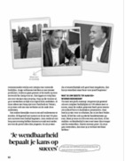
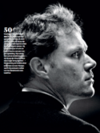
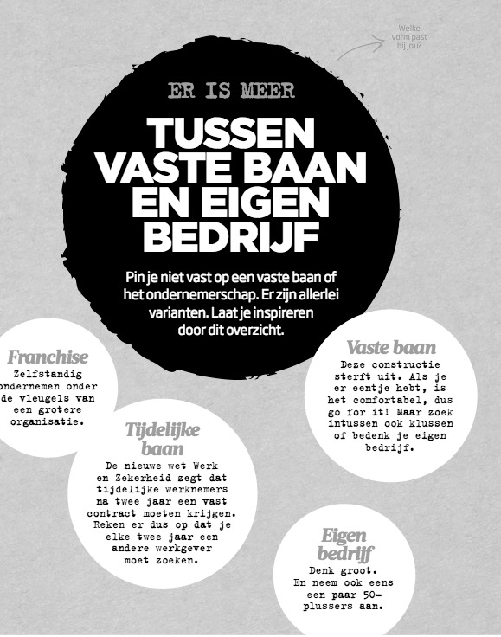
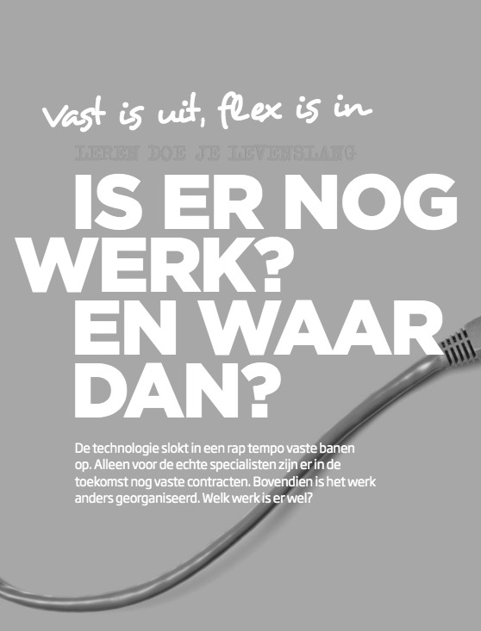
The Big 50+ Workbook

Slide 6
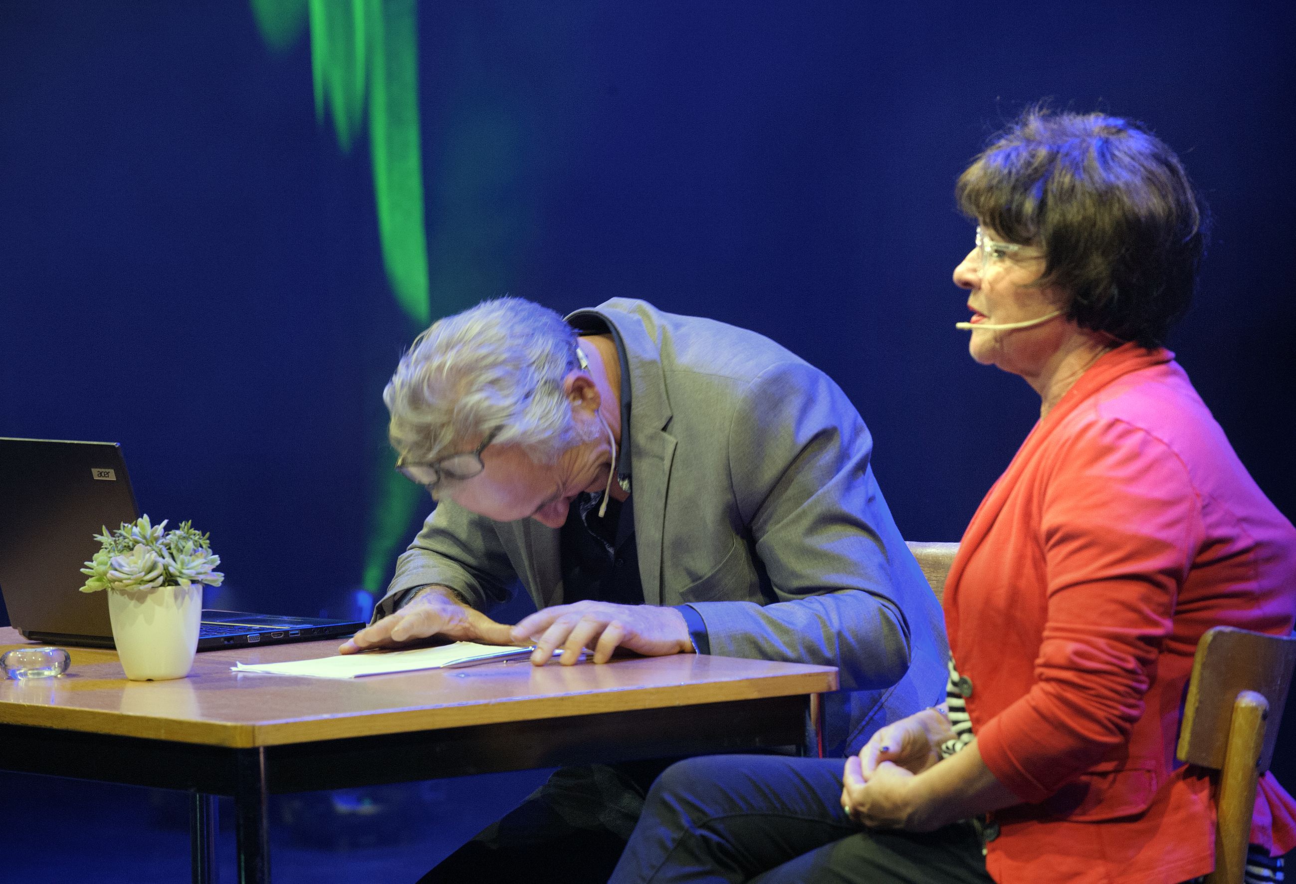
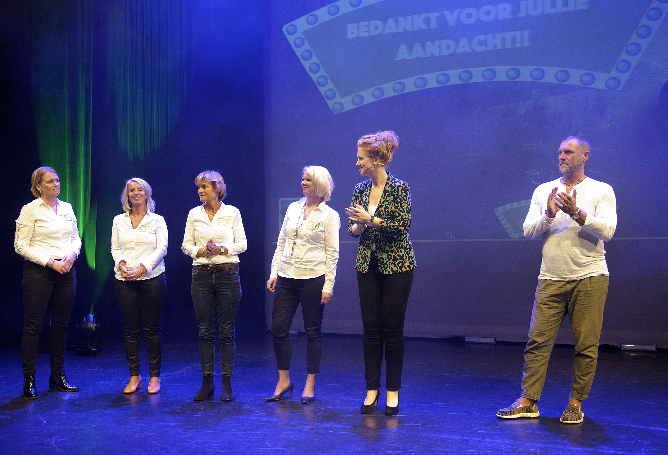
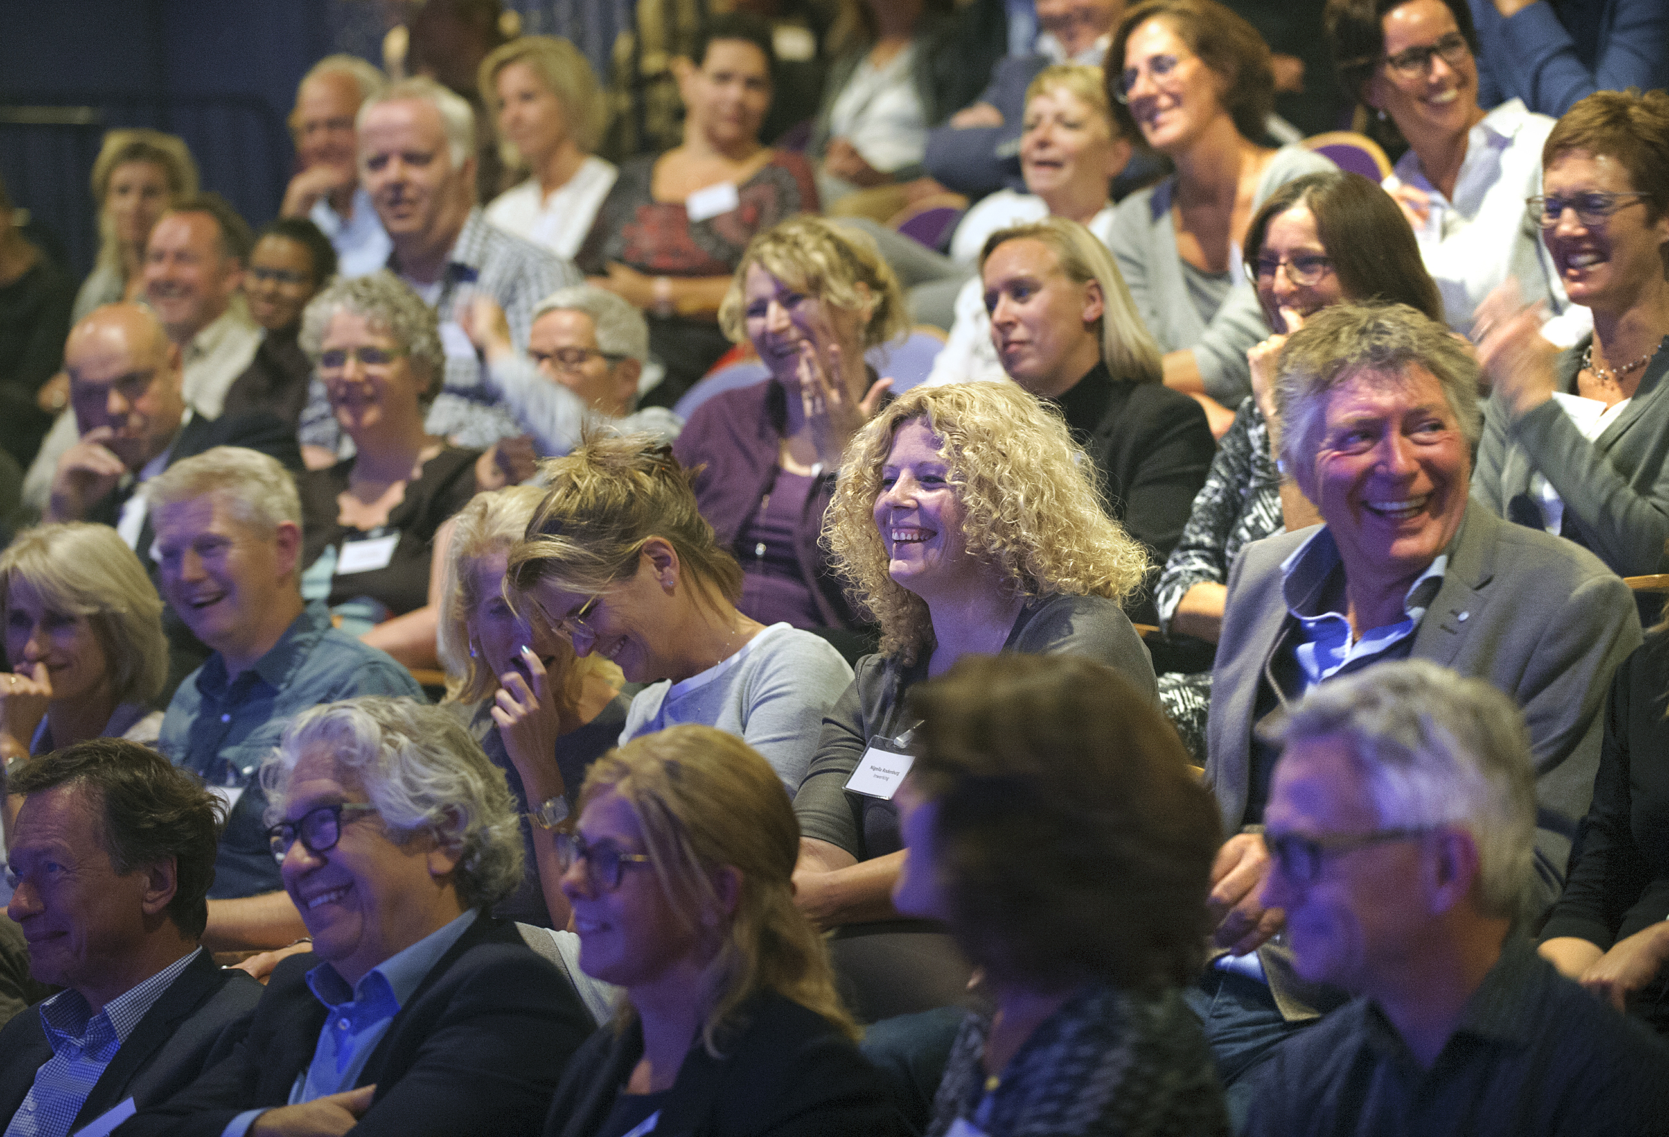

Slide 7
Let’s
talk
about
50+

Slide 8
Not the problem
The Problem
the market or employers
imaging

Slide 9
The
changing
labour market

Slide 12
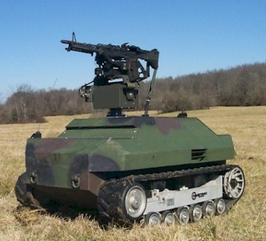
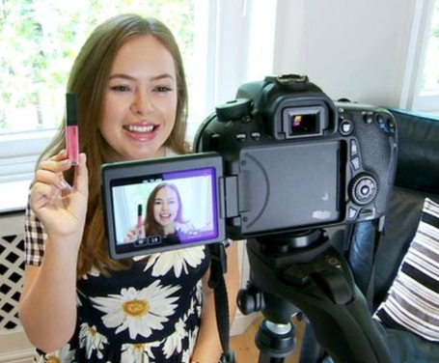
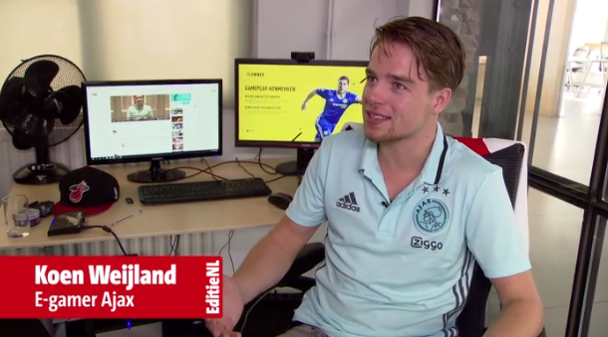
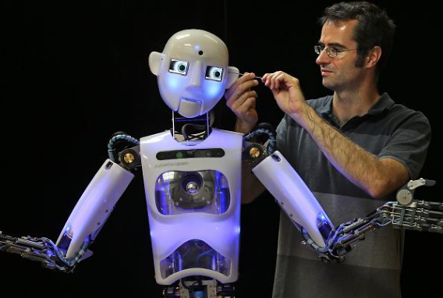

Slide 13
How it was…
learning
(4-20 years)
working
(21-65 years)
retirement
(66-75 years)

Slide 14
How it is…
learning
(0-15 jaar)
learning
working
resting
(15-70 jaar)
retirement
(70-95 jaar)

Slide 15
The 50+ Question

Slide 16
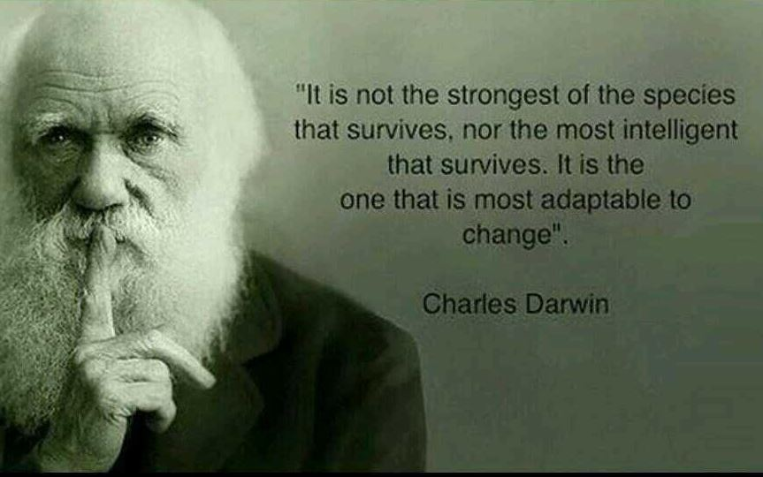
CHANGE

Slide 17
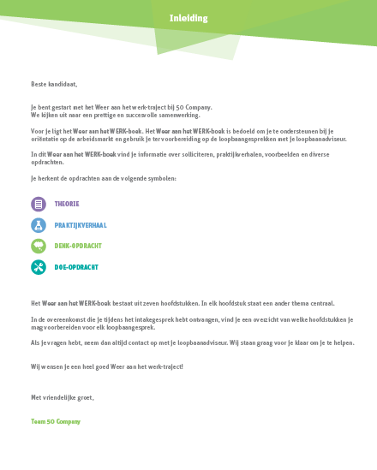
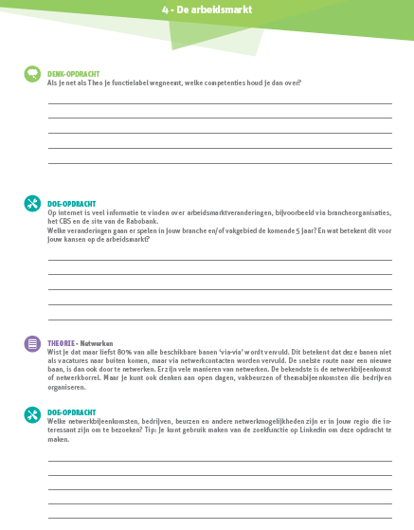
OUR METHOD

Slide 18
DE-LABELING

Slide 19
NETWORKING
80%

Slide 20
EUROPEAN
TO DO LIST
attention for changing labour market
life-long-learning
sustainable career planning
de-labeling
added value based recruitment
stop the negative imaging

