Slide 2
Why this topic again
We have to speak again and again about older people and the media. Three years ago I had the honour to address you with a similar title : Older Women in the Media, their Access to Modern Communication and Information Technologies.
What has happened in the past years that makes this issue so important that we should revert to it? Undoubtedly, many things happened but even more did not happen so the topic remains actual and even more important.
Ageism and gendered ageism is a big challenge for society, and media is part of the problem, but could of course also challenge and expand the ideas on ageing.
It is widely recognized that how we approach old age is conditioned upon culture. Media is undoubtedly the largest cultural arena in which societal images and attitudes towards old age and older people are formed.
It is therefore pertinent not only understand how different types of online and offline media represent ageing and old age, but also how people of different ages access and use those media and what types of knowledge about media they have.

Slide 3
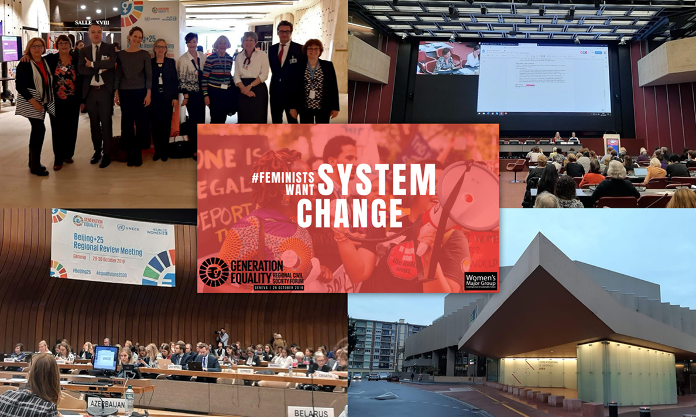
Beijing+25
For the celebration of the 25th anniversary of the Beijing Declaration and Platform for Action (BPFA) the governments and civil society from the United Nations Economic Commission of Europe, met in Geneva to review progress on this milestone from 1995. AWDCH together with NGOs from 45 countries participated in the civil society forum.
A report was complied on the positions of the working groups.
Several topics were discussed, like:
Ending discrimination against women and girls in all their diversity
Ending violence against women, girls and women human rights defender
Ensure women’s rights in media, education and technology access
Among media topics there were some which did not exist 25 year ago:
Social media was non-existent in 1995
With Artificial Intelligence (AI) and Automated-Decision Making (ADM) we face new opportunities
In parallel with the digital gender gap, media literacy is one of the most important topics due to the fast changing digital/social media. All citizens should be able to discern discriminatory content, fake news and to protect oneself from data breaches.

Slide 4
Forms of ageism in media
Media can propagate stereotypical perceptions on ageism but can be challenged to become our ally in combat against ageism.
Which are the most common forms of ageism in media?
Verbal
Using inappropriate expressions, language when addressing people of certain age or speaking about them
Visual
Showing older people in situations they are not comfortable with
Advertising products for older people with much younger models
Focusing older people’s disadvantages
News
Focusing on age of a person not on their values or achievements
Inappropriate, devaluating messages like:
Can not cope with technology changes
Keep jobs and positions the younger should have…..
Greatest danger is, that the society, and even older people themselves are so used to it that do not notice and do not have a quick and appropriate reaction.

Slide 5
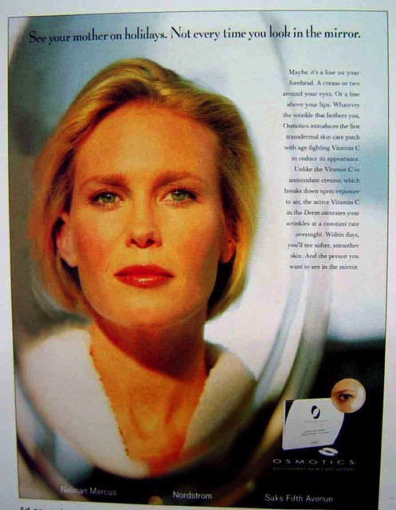
Examples of everyday ageism in media
Ageism is everywhere, yet it is the most socially “normalized” of any prejudice, and is not widely countered – like racism or sexism.
Facebook, officially bans hate speech based on categories including race, nationality, religion and gender – but not age.
In media older women are portrayed much more often in negative ways than men.
Image of men in their 60 are often portrayed as funny, attractive, active while women are often showed in negative connotation.
Most of the older characters in films and TV shows are men and females are less visible

Slide 6
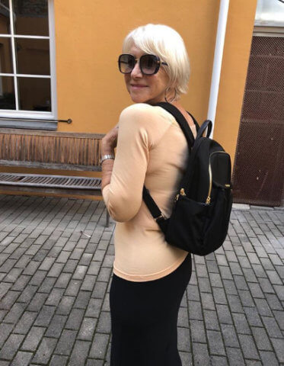
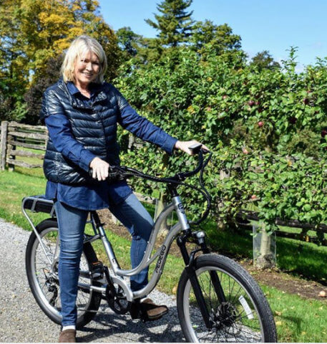
These are the words commonly associated with the elderly in the media. Technology and the ever-changing aspects of mass media form a gap between the elderly's old school values and new school ideas.
Dame Helen Mirren, age 73, posted a photo on Instagram, taken while she was in Lithuania. She was sporting a sleek black Tumi backpack strapped over her shoulders. After receiving nasty remarks she posted: ‘Who says it’s a no-no! Why not defy these silly rules and make it a yes-yes.”
Martha Stewart who is in her late 70’s answered to her critics: “I feel sorry for you if you think I am too old to bicycle. I keep in excellent shape by doing many outdoor and indoor exercises and activities!”

Slide 7
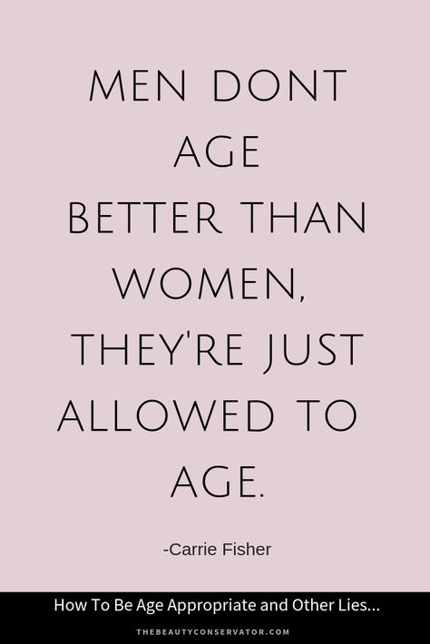
Old age is the future of the youth
What everyone needs to grasp is that to be ageist is to hate your future self. My age is 69. That’s a fact. But why should that come with any negative connotations?
The common perception among advertising agencies is that younger age groups spend more than older age groups. Recent studies show that while 65-73-old consumers outspend their counterparts in the 35-44-year category, their potential power as consumers is ignored.
Advertisers focus their marketing on younger women who are primarily responsible for household purchases. But 60+is the fastest growing market for smartphones, social media and internet services and on dating sites; they’re financially less risk-averse than younger people.
Media still show a continuing negative portrayal of older persons manifested mostly through comments referring to decline and deterioration in old age.
People are seldom depicted as experienced elders. Rather, older people who are tolerated and respected to the extent they can act like younger people and work, exercise, and have healthy relationships.

Slide 8
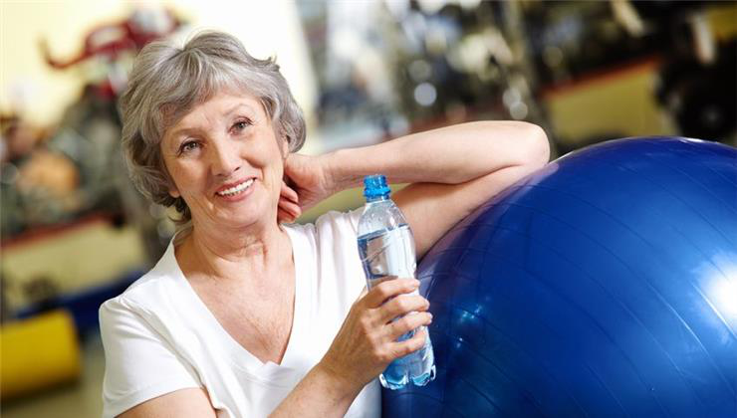
Slowly changing picture
There have been some shifts in the ad industry recently. You see more older actors and actresses capturing the true experience of ageing now. There’s more positive representation of older age and that will be crucial in improving attitudes over the longer term.
McCann, which runs a network of advertising agencies, suggested in a report last year that marketing campaigns consider perspectives of aging as “a journey of limitless opportunities and personal growth” rather than “as a time of anxiety and uncertainty.”
In 2019 customer searches on Getty for images of “seniors” had increased 151 percent from a year earlier. The most popular image in the category now shows a group of women in T-shirts practicing yoga. A decade earlier, the best-selling photo featured a couple in sweaters embracing on a beach.

Slide 9
Why do we have to challenge the current media approach?
Media consumption habits have changed
Media has become imminent part of the everyday life of all generations. The first online generation is already in retirement, and we spend as many hours before the screens as our grandchildren. We use media also differently than decades ago. Instead of reading a magazine or watching our favourite TV shows we are online now, often using more than one screen simultaneously. We use streaming services, rerun shows from the 80ies and are ready to pay for the online edition of our favourite magazines or dailies.
Media content has changed
There are shorter articles, more pictures, the episodes of the series are shorter and artists who refused to appear on a tv show earlier now are happy to get a brief role in the 3rd season of a Netflix show.
News have changed
Perhaps the greatest challenge of all media related issues is the spread of fake news and fake portals

Slide 10
Social media is the main tool to generate changes
Social media can play an important role in educating, promoting and driving action to oppose negative perceptions on ageing.
What social media platforms do older adults use?
According to Pew Research’s most recent social media factsheet, 69% of adults between 50-64 and 40% of those above 65 use social media.
41% of Facebook users are 65+. As of the third quarter of 2019, Statista reported that 58 % of adults above the age of 56 use YouTube. *
Influencer marketing is all about lifestyle. We can see many influencer campaigns for the millennia generations or even younger, but not for the older people. Social media users tend to follow personalities they can relate to, so if the target market is over 50, they are probably following people of a similar age.
If a brand becomes known for only showing its products being used by younger generations, older customers will simply lose interest. A product should be shown to be used by the people being targeted, not simply the hottest face currently on the market.
Although younger generations use different platforms mainly, but seeing older people active on FB, Twitter or Instagram, the first steps are already done. The younger generations must see that people can live fulfilling and active lives as they age.
*USA and EU

Slide 11
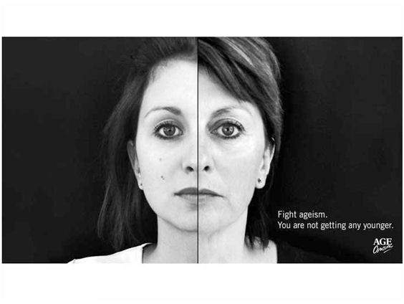
What can we all do about ageism in media?
I am 69 today. And enjoy driving a car. In 15 years time my eyes might disappoint me but will still want to enjoy driving a car. Any solution? Yes!
My hope is that technology will help me and self driving cars will be the norm. So why not embrace technology?
Speak up about your age. There is nothing to be shamed of. Your age is your experience in life.
Be active on social media. Your voice will be heard.
Tell people.
Ageism is prejudice against their feared future selves.

Slide 12
Special Thanks
to INPEA (International Network for the Prevention of Elder Abuse)
for their long year professional cooperation
We would like to thank herewith to the
Hungarian Ministry of Human Capacities
for sponsoring the participation of AWCDH
in the CSW64

Slide 13
GET IN TOUCH WITH:
Mrs. Katalin Hajós
Founding board member of the Association for Women's Career Development in Hungary
Ugron Gábor u. 28.
H-1118 Budapest, Hungary
Phone: +36 1 319 5245 • Mobile: +36 20 921 5319 • Fax: +36 1 319 2017
E-mail: hakaaa@gmail.hu
www.womenscareer.org

