Slide 1
“SUPPORTING RURAL OLDER WOMEN’S EMPOWERMENT
IN CENTRAL AND EASTERN EUROPE”
Andrea Ferenczi
President of AWCDH Board Member of Older Women’s Network Europe
RURAL OLDER WOMEN/WIDOWS:
BEYOND POVERTY AND VIOLENCE:
PROGRAMS/POLICIES
CSW62 PARALLEL EVENT
Date and Time: March 14 from 12:30 PM to 2:00 PM
Venue: 4 W 43rd Street, Room: Green Room

Slide 2
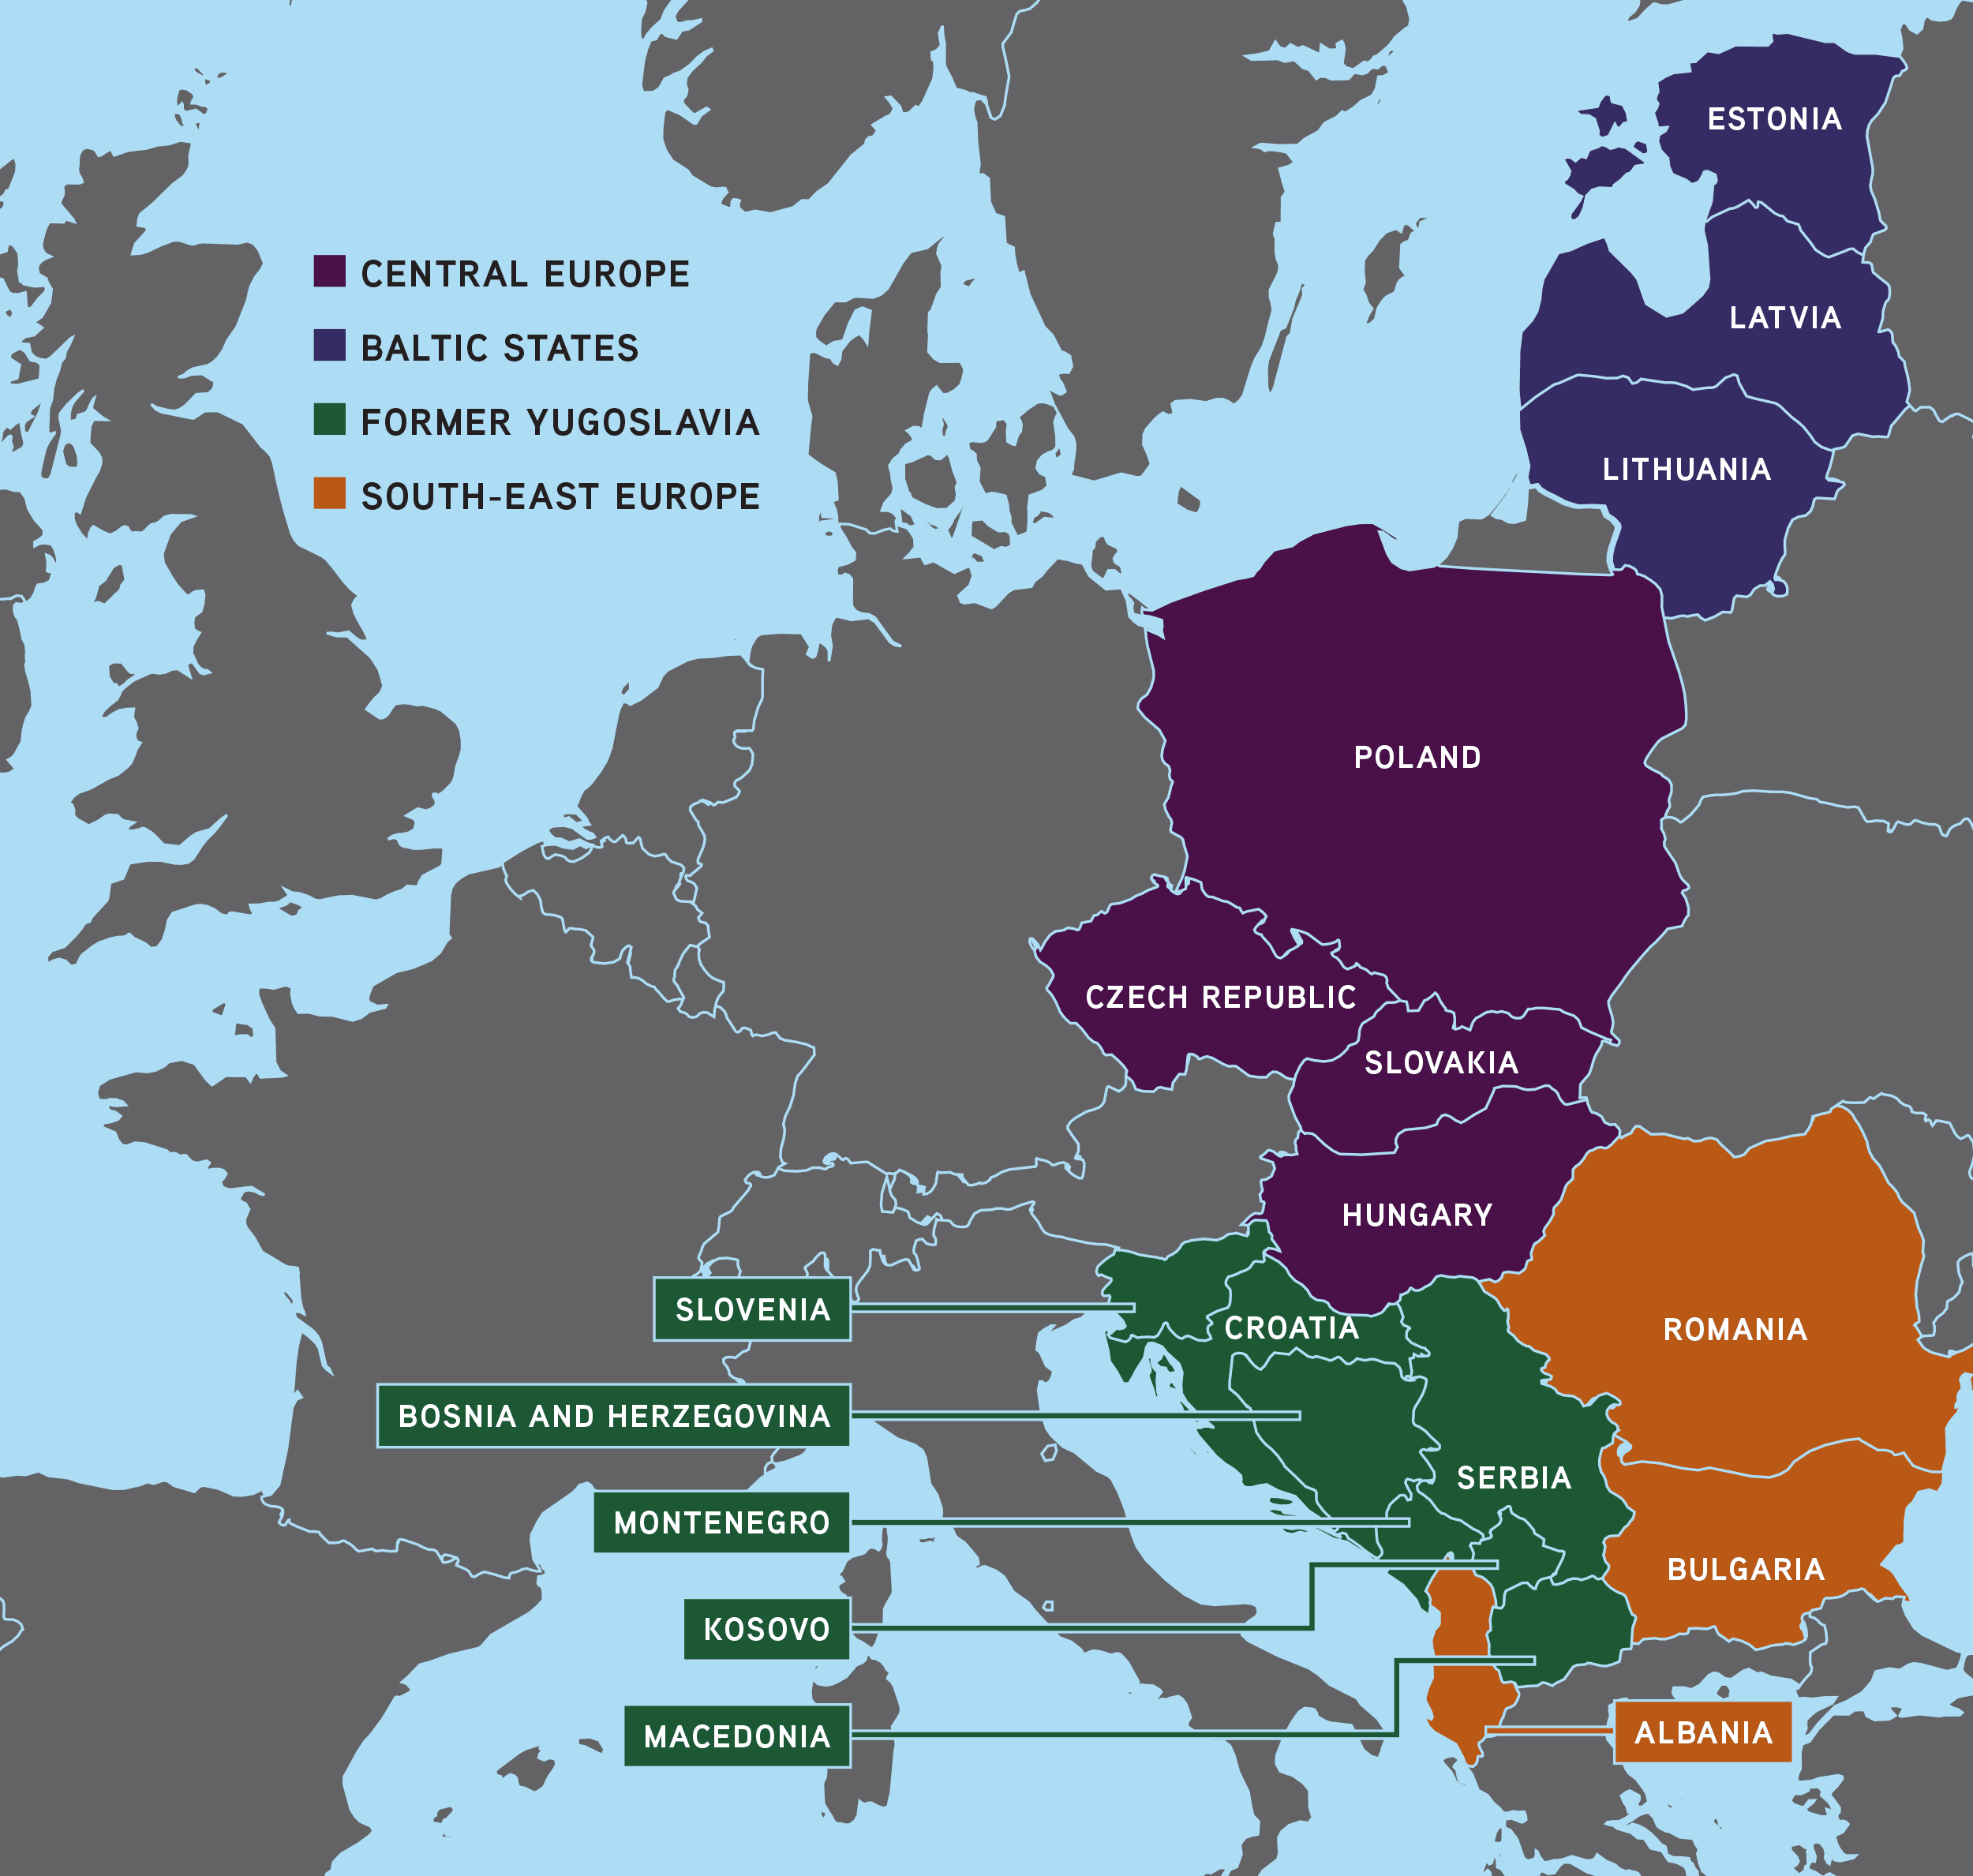
THE CEE COUNTRIES IN THE EU
Though the EU is a highly developed economic region, there are big differences between the member countries.
The population of the 28 EU Member States is nearly 512 million. (CEE - about 100 million).
Western Europe is the most developed region, while in comparison, the economies of the CEE
countries lag behind.
Compared to the overall population, the number of people over 65 in the EU averaged 14.9% in 1996, 19.2% in 2016, and in the CEE countries this rate is similar.
In this area farming was always important thanks to good natural conditions and traditions.
Hungary and the Carpathian Basin are rich in natural resources and environmental treasures.

Slide 3
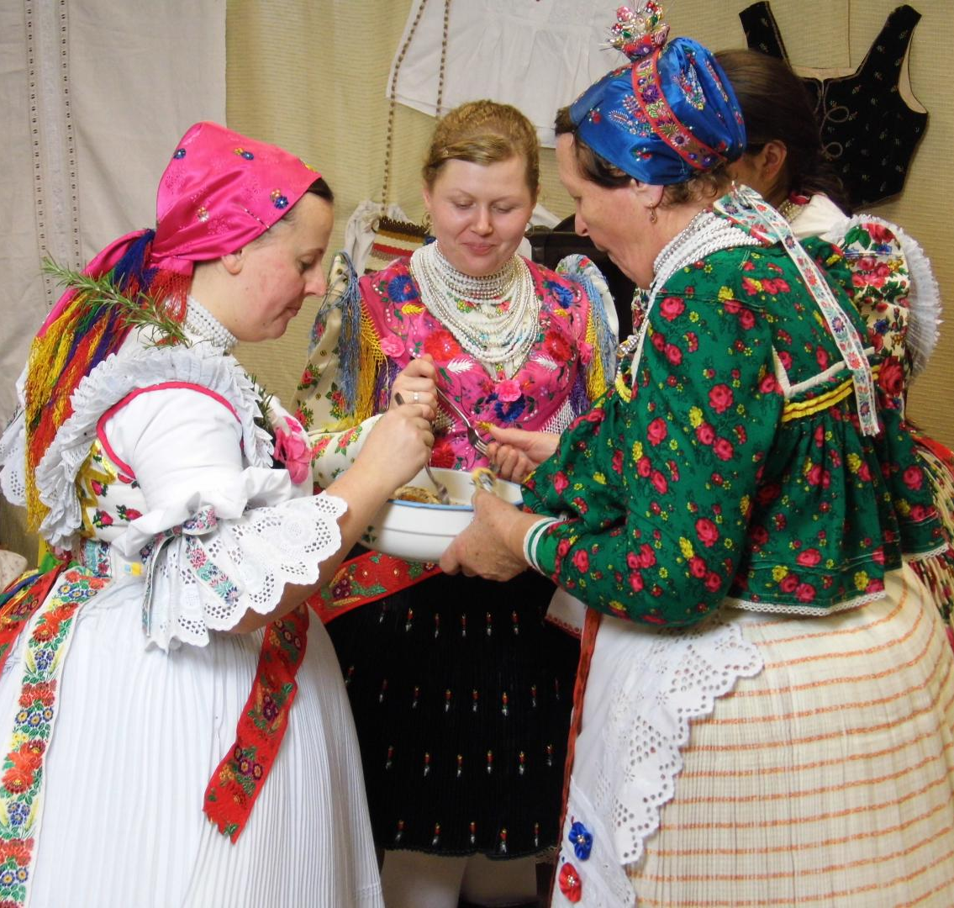
OLDER RURAL WOMEN AS A VALUE
The knowledge of older women has been highly valued in the past, and from them young people have learned child rearing, household and gastronomic skills.
They gave an example of life-thinking, mentality, folk art, and crafts.
In harmony with EU strategy in the CEE countries cultural heritage is important and older women have the opportunitiy
to present their traditional skills at village festivals and religious events.
On TV, on the radio and on the internet, they promote the folk traditions of the different regions in Hungary.

Slide 4
OLDER WOMEN IN RURAL AREAS
The demographic challenge in the EU and in Central and Eastern Europe (CEE)
The proportion of older people in society is growing due to longer life expectancy,
particularly in the case of women.
As a result, many live alone in older age and this can bring widowhood and loneliness.
Older rural women often live in single households where women 65+ are much more subject to poverty than men due to their non or shorter working lives and lower incomes.
Victimization of older women in Hungary
According to a population survey, the elderly are afraid in Hungary (and across Europe): of disease, health problems, loneliness, offences. In Hungary 60-70 % of crimes are against properties. Most crimes committed against old people (mainly old women) are also crimes against property: which are the so-called tricky thefts, tricky fraud, thievery with distraction, and robberies against the elderly.
The number of such crimes has decreased in recent years in Hungary thank to massive Police prevention campaigns.

Slide 5
Older women in rural areas – Their work
Those who still can work produce healthy foods for themselves and their close family members.
For some, the surplus is sold on the market as a supplement to their pension.
However, what is most important to them is socializing. The market is a very important meeting place for people living in the countryside. Here they meet with each other and chat about their daily joys and problems, listen to the loudspeaker announcements in the market, learn who has died and for whom a mass will be held.
Older women in rural areas – Their family life
(when they have a family)
Formerly in the countryside, generations lived together, but this is no longer typical.
At the same time, families in the CEE region still try to maintain regular close family relations.
The older people want to help their children and grandchildren.
When old people have health problems, the family tries to solve their care in their own home, since they are reluctant to put them in a nursing home, which is considered a “shame”.

Slide 6
Entertainment possibilities in community life
This depends on whether the person stays at home or takes part in social life.
(Subject to their mobility of course.)
Older women usually take part in programs organized by local government and pension clubs, which offer a wide range of programs, e.g. artists and performers
are invited or lecturers who speak on health and safety issues.
They organize meetings, revive local customs and traditions that help to keep tradition alive.
At the same time there is also the interest in modern life and tools. They often take part in activity courses, computer or language courses. They can keep in contact with their children and grandchildren who live far from them or in other countries by using internet and skype.
Social services available to them
One of the positive things in the communist system was the widely available social aid system, which has been maintained in the CEE countries.

Slide 7
THE ASSOCIATION FOR WOMEN'S CAREER DEVELOPMENT IN HUNGARY (AWCDH)
“SUPPORTING RURAL OLDER WOMEN’S EMPOWERMENT IN CENTRAL AND EASTERN EUROPE”
OUR GOALS:
to help promote women’s empowerment active in all major sectors of life
to advance the dialogue
between legislation, government, the profit and non-profit spheres, academia, and all potential stakeholders of AWCDH
in order to meet economic, social, cultural and educational challenges.
We can convene a think tank from dedicated members of AWCDH, well trained
professionals in his or her field who put their knowledge and expertise at the service
of the goals set by the Association.
Representation of the interest of special women’s groups.
Since our foundation in 2003 we have prioritized the inclusion in our programs of women from rural areas.

Slide 8
AWCDH’S PARTNERS IN KNOWLEDGE TRANSFER AND IN NETWORKING:
THOSE WOMEN WHO CAN HELP LOCALLY
We concentrate on networking and on the transfer of knowledge. Our partners are
mainly skilled active rural women of all ages who are seeking new information and
who are able to use it in the interest of their local community:
They are the local decision-makers, opinion leaders, many of whom are older women, who are known and accepted by the community. In particular they are doctors, teachers, nurses, mayors and local government officials, entrepreneurs, chamber representatives, local notabilities, and so on.
Rural women as role models:
Those who live there and who can understand their environment in its complexity, and
can move on the spiral of change and generate a change,
those who can translate EU initiatives into the local environment and can change local lifestyles, and by their motivated work act as a driving force for everyone,
Those who can co-operate with different generations, learning from each other in the family and beyond formally and informally - life-long.
We do network however only with leaders and role models, but it is also important to us that we meet fantastic “average older rural women”, when we are invited, for example to festive events or nursing homes.

Slide 9
WHAT CAN AWCDH DO FOR OLDER RURAL WOMEN?
To learn best practices, exchange of experiences
Activate, motivate
Honor and involvement
Networking
Cooperation of generations
Good media relations
HOW? OUR TOOLS
Thanks to our European Union and United Nation level networks,
we can adopt all positive foreign best practices
within a Hungarian framework on one hand,
and present exemplary Hungarian practices on the other.

Slide 10
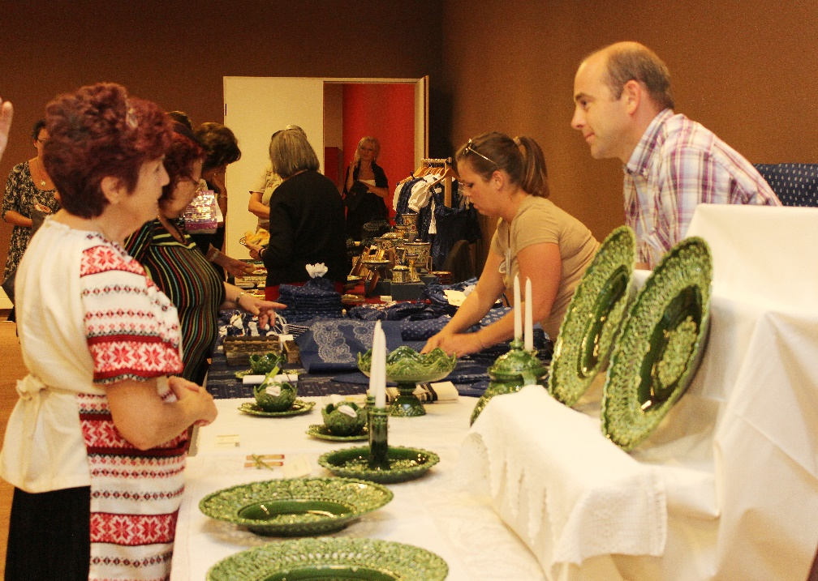
WHAT HAVE WE DONE / OUR REFERENCES
Since the foundation of the AWCDH in 2003, we have prioritized the inclusion in our awareness raising programs of women from rural areas. We have organized more than 30 international conferences dealing with employment and career opportunities for women of all ages incl. “Women for Sustainable Development − The Role of Women in Rural Development” International conference in 2012, “Mayors for Equal Opportunities” Conference in 2005 and our first conference “Women’s Role in Regional Development and Public Life” was held with the aim to prepare women leaders from the country side for our European Union membership.
At some of our international conferences we also displayed products created by rural female artisans and called these small events “Rural Women’s Corners”.
In 2013 however, we also organized a large event at the “Rural Women’s Day” on Hungexpo Fair Centre in Budapest. This event included artisan’s exhibitions, gifts, table ware and a fashion show.

Slide 11
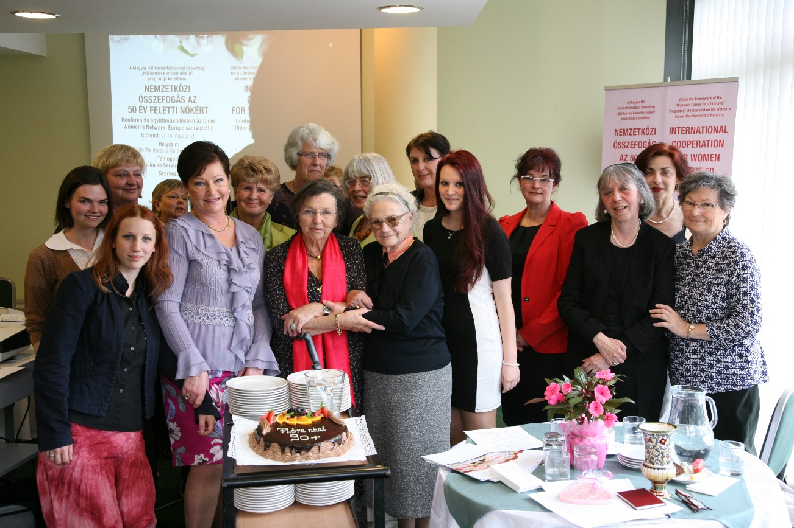
Awards for Honor and Involvement, as long as possible
We have awarded our Mentor, Dr. Flóra Szakácsi–Tápai, Agricultural Engineer
on her 90+ Birthday with our “Lifetime Achievement Award” on 31st May 2014 in Budapest

Slide 12
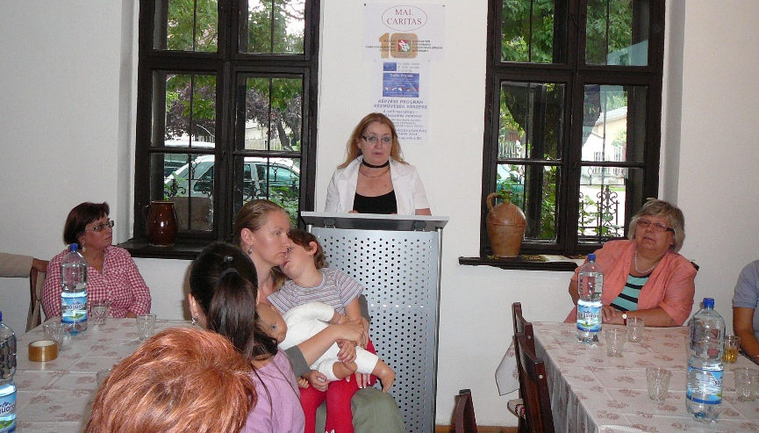
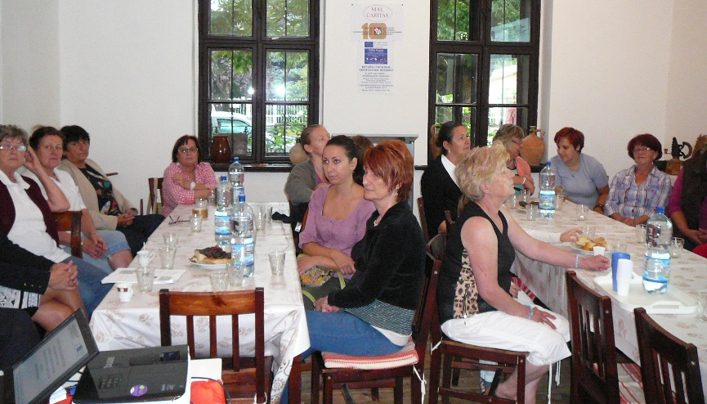
EU Project (2013-2015)
The AWCDH has successfully implemented the
“TRAME-Transferring Competencies through Self-Narration and Mentoring Process” Project within the frameworks of the Lifelong Learning Program - Grundtvig Adult Education Program of the European Union. Within this framework we had the opportunity to present to our Irish, Maltese, German and Turkish partners and on other European forums that Hungarian folklore and craftsmanship (and in this context centuries of knowledge transfer from generation to generation) are unique in the world. Building on good examples from abroad and building upon Hungarian traditions, the AWCDH’s expert team has developed a professional manual for the self-narrative education program for artisans available for all EU countries.

Slide 13
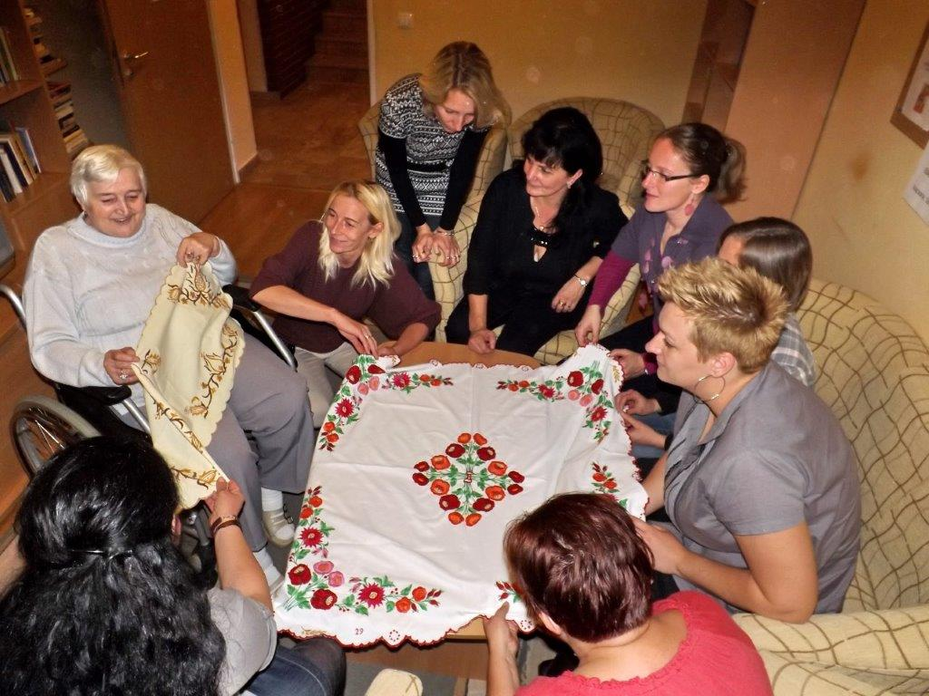
An excellent example of our self-narration program is this successful transfer of knowledge from a resident in the Szépkorúak Idősek Otthona” Nursing Home, Süttő
In 2015 Mrs Ildikó Haraszti, Director of the nursing home and ageing expert of the AWCDH, noticed that a resident, Mrs Hartman, affectionately known as “Aunt Gizi”, was very skillful at making beautiful embroideries. Therefore, Ildikó organized “knowledge transfer events” which attracted young girls to visit and learn Aunt Gizi’s embroidery making skills and listen to “auntie’s” stories about her fascinating life.
She is convinced that “the method helps keeping identity in older ages”.

Slide 14
OUR PROFESSIONAL NETWORK:
UN: ILO, WHO, FAO, UNECE, UNESCO
EU: EP: Committee on Women's Rights and Gender Equality
AGE Platform Europe, OWN Europe and other European NGOs,
US NGOs
In Hungary:
National Assembly Committee on Employment and Labour, National Council on Ageing, Ministries, Local Governments, Hungarian Academy of Sciences, Hungarian Labor Inspectorate, EBH - Equal Treatment Authority, National Institute for Food and Nutrition Science, Hungarian Central Statistical Office (HCSO) Demographic Research Institute, Gerontology Science Coordination Center, Faculty of Health, University of Debrecen, Hungarian Scientific Association of Rural Health, Crime Prevention Department of the Hungarian National Police, Magyar Vöröskereszt (Hungarian Red Cross).
Embassies

Slide 15
Special Thanks
to INPEA (International Network for the Prevention of Elder Abuse)
for their long year professional cooperation
and for sponsoring the CSW62 Parallel Event titled
Rural Older Women/Widows: Beyond Poverty And Violence
Programs/Policies
and for inviting the AWCDH as co-sponsors.
We would like to thank herewith to the
Hungarian Ministry of Human Capacities
for sponsoring the participation of AWCDH
in the CSW62

Slide 16
GET IN TOUCH WITH:
Mrs. Andrea Ferenczi
President of the Association for Women's Career Development in Hungary
Ugron Gábor u. 28.
H-1118 Budapest, Hungary
Phone: +36 1 319 5245 • Mobile: +36 30 982 7093 • Fax: +36 1 319 2017
E-mail: ferenczi@t-online.hu
www.womenscareer.org
International Organizations:
National Representative of INPEA (International Network for the Prevention of Elder Abuse)
in Hungary,
Member of the NGO Committee on Ageing, Geneva,
Member of the Employment and Active Ageing Expert Group of AGE Platform Europe,
Board member of the Older Women’s Network, Europe.

