Slide 1
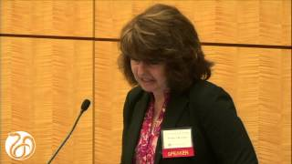
Research on Older Rural Women and Domestic Violence in the United States of America
Pamela B. Teaster, Ph.D.
Secretary General, International Network for the
Prevention of Elder Abuse
Professor and Director, Center for Gerontology
Virginia Tech
E-mail: pteaster@vt.edu

Slide 2
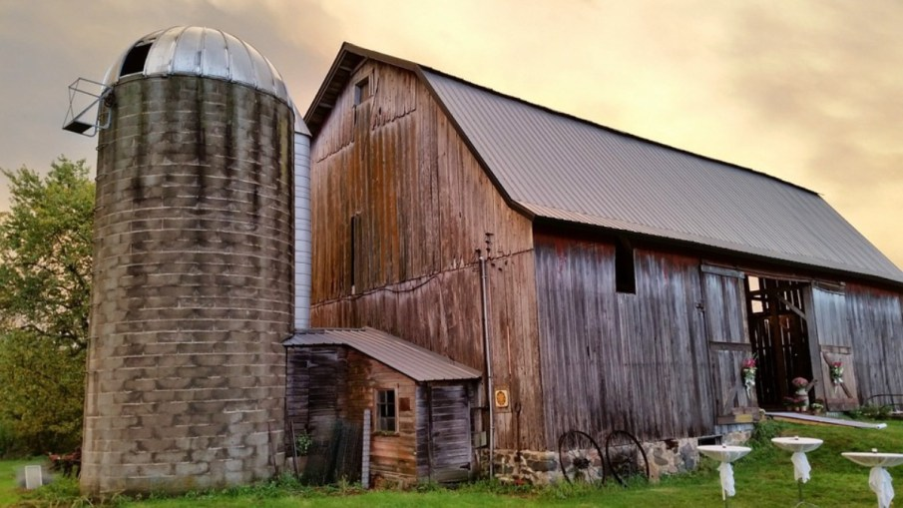
Objectives
Learn the nature of domestic violence of older rural women
Understand the scope of the problem
Explore implications of research findings for prevention and intervention

Slide 3
The Nature of the Problem
Intimate partner violence (IPV) describes physical, sexual, or psychological harm by a current or former partner or spouse that can occur among heterosexual or same-sex couples and does not require sexual intimacy
(Centers for Disease Control and Prevention, 2013)

Slide 4
A Culture of Silence
Officials do not take reports seriously
Regarded as a family matter
Abusers rarely removed or prosecuted
Services to address the problem are still lacking
Regarded as “abuse grown old”

Slide 5
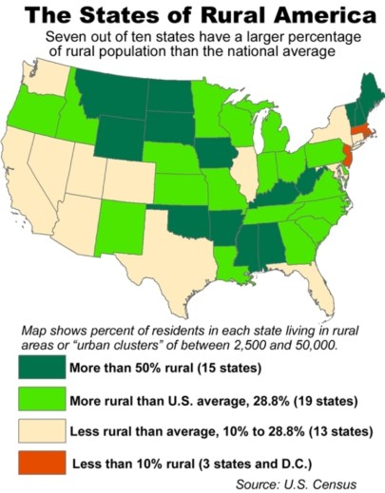
Rurality
One out of four adults 65+ live in rural areas, or 10 million older adults.
15.4% of rural Americans live in poverty, compared to 11.9% of urban residents.
Coats, D. 7 July 2016. Can rural America rise again? Mihaylo News. Online at http://business.fullerton.edu/news/2016/07/07/the-american-economy-can-rural-America-rise-again/

Slide 6
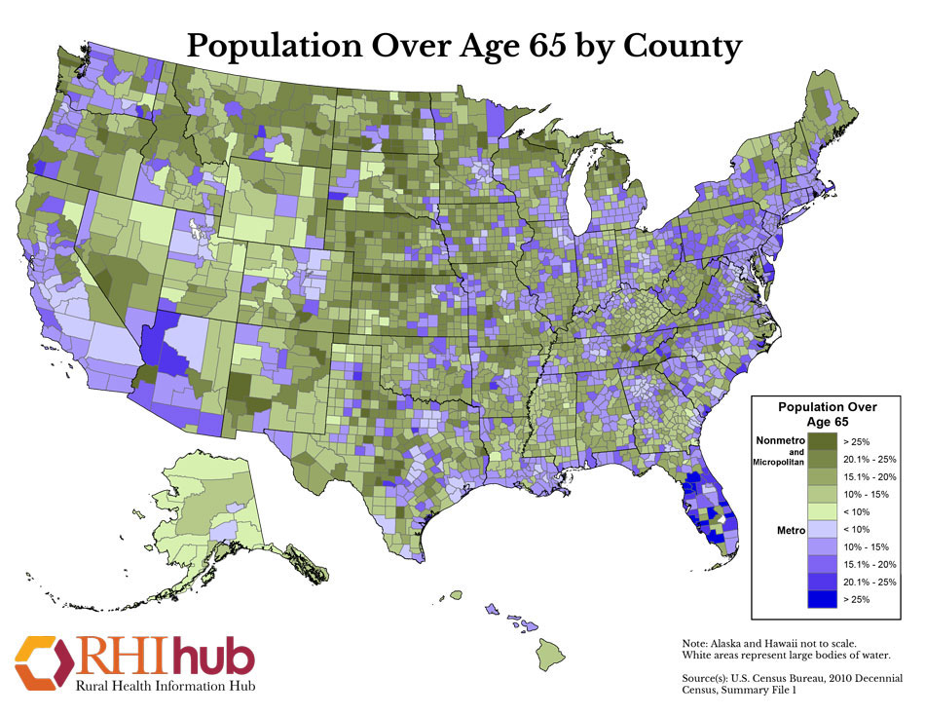

Slide 7
Framing Matters
The immediate context in which the abuse takes place
Macrosystem
Exosystem
The relationship between the woman, her family, church, and related settings
Mesosystem
Microsystem
Environments distal to the woman that may affect her well-being such as service agencies
Woman
Includes broad ideological values, norms, and institutional patterns of a particular culture and geographic location

Slide 8
Background
Roberto, K.A., & McCann, B.R. (2018). Violence and abuse in rural older women’s lives: A life course perspective. Journal of Interpersonal Violence, 1-23, DOI: 10.1177/088626051875490.
Weeks, L. E., Macquarrie, C., Begley, L., Gill, C., & Leblanc, K. D. (2016). Strengthening resources for midlife and older rural women who experience intimate partner violence. Journal of Women & Aging, 28(1), 46-57.
Brossoie, N., & Roberto, K.A. (2015). Community professionals’ response to intimate partner violence against rural older women, Journal of Elder Abuse & Neglect, 27:4-5, 470-488, DOI: 10.1080/08946566.2015.1095664
Bender, A.K. (2016) Health Care Experiences of Rural Women Experiencing Intimate Partner Violence and Substance Abuse, Journal of Social Work Practice in the Addictions, 16:1-2, 202-221, DOI: 10.1080/1533256X.2015.1124783
Teaster, P. B., Roberto, K. A., & Dugar, T. A. (2006). Intimate Partner Violence of Rural Aging Women. Family Relations, 55(5), 636-648.

Slide 9
Considerations for Older Rural Women and IPV
Can be a lifespan problem
Patterns of violence and abuse can change and persons age
Financial security
Cherished relationships
Physical and mental challenges for some

Slide 10
Scope of the Problem: IPV, Older Adults & How Much Exists
1.4/1,000 women reported new exposure to physical abuse and 46/1,000 becoming victims of verbal abuse (Mouton, 2003).
According to the Behavioral Rick Factor Surveillance System, lifetime prevalence of 26.5%, with many abused women reporting more than 20 episodes of violence in their lifetime (Bonomi et al., 2007).
Mouton, C. P. (2003). Intimate partner violence and health status among older women. Violence Against Women, 9(12), 1465-1477.
Bonomi, A. E., Anderson, M. L., Reid, R. J., Carrell, D., Fishman, P. A., Rivara, F. P., & Thompson, R. S. (2007). Intimate partner violence in older women. The Gerontologist, 47(1), 34-41.

Slide 11
Rates of Elder Abuse in New York State: Comparison of Self-Reported One-Year Incidence and Documented Case Data
Documented Self-Reported Ratio of Self-Reported
Rate/1,000 Rate/1,000 to Documented
All forms of abuse 3.24 76.0 23.5
Financial .96 42.1 43.9
Physical and Sexual 1.13* 22.4* 19.8
Neglect .32 8.3 57.2
Emotional 1.37 16.4 12.0
*The Documented Case rate includes physical abuse cases only. Physical and sexual abuse data were combined in the Self-Reported Study. The sexual abuse rate for the Documented Case Study was 0.03 per 1,000.

Slide 12
Study Locations
Ashland
Prestonsburg
London

Slide 13
IPV of Older Rural Women (Focus Groups)
Family Context
Grown children (supportive or not), long-term marriage, isolation, devotion to religion
Impetus for the Abuse
Disability, medication interactions, mental illness, controlling behavior, jealousy, dementia, failing health
Types of Abuse
Verbal, physical (ongoing or one-time), stalking
Presence of Weapons
Impetus to Leave
Death threat, threaten grandchildren, disability

Slide 14
IPV of Older Rural Women (Focus Groups)
Characteristics
“Comfortable” with the abuse and more reluctant to leave
Increasing verbal abuse
Children have grown used to the abuse
Few experiences/knowledge outside the home
Many family members living together
Established “way of life,” a “woman’s responsibility”
Fear of retaliation
Frailty/increasing health problems
Poverty
Rural environment—everyone knows everyone
Cycles

Slide 15
Challenges for Service Provision (From Focus Groups)
Ongoing patterns of behavior not always taken seriously by law enforcement, social services, and health care providers
Safety of persons investigating cases
Lack of education, lack of financial resources
Victim is unaware that abuse is occurring
Victim is unaware of resources
Inadequate housing, transportation options
Lack of case follow-through
Adults without “the wedge” of children, refusal of services

Slide 16
Examples of the Abuse
“When he was drunk, if I did something wrong or whatever, once he threw a fork at me and just missed my head once and hit the wall, threw a shoe at me…he was easy to fly off.”
“He’d be gone all day and come in and he wanted sex, he raped me several times, and I thought it was a husband’s right…”
“He killed the cat in front of me and my son one time, strangled it. Because we were paying too much attention to it.”

Slide 17
The Impetus to Leave
“Well, the day that I run him off and got my divorce was he knocked one (child) down and the floor and he got a real black eye.”
“In Kentucky in 1966, you couldn’t file for divorce if you were pregnant. They knew I was pregnant, it went through.”
“When I came back to my car, he had shot holes in my car, burned all my clothes, all my personal items, he just went crazy.”

Slide 18
The Women’s Needs
“…What was happening…was that my mental state was in such a bad condition that I started shutting my body down. I did not want to go on anymore.”
“I had all kinds of needs, I had emotional needs very bad. I was in bad shape because I was led to believe that’s how women are supposed to be, they’re supposed to take that.”
“I don’t really feel safe, ‘cause I’m a sick person right now, but I don’t feel safe.”
Notes:
The role of rural culture/environment, The role of poverty, The role of education, The role of religion
The role of the community, The role of the government, The role of the women victims
State & Local Police
Judges/Courts
Education
Health Care
Transportation
Housing
Faith-Based Interventions
Financial Commitment

Slide 19
Unwinding the Findings
Older adults sustain serious mental and physical injuries from which they are less like to recover than their younger counterparts
Important to alter public views of IPV of older women
More services are needed
Elder shelters needed
Different cultures regard IPV differently

Slide 20
Resources
International Network for the Prevention of Elder Abuse
World Health Organization
National Clearinghouse on Abuse in Later Life
National Committee for the Prevention of Elder Abuse, National Adult Protective Services Association, National Center on Elder Abuse
Health care professionals, faith leaders, law enforcement

Slide 21
Because, if I can touch one person’s life it will make it all worthwhile, well, of all these…years of being abused in every way, my nose has been broken like seven times, my eardrums have been burst, and if I can reach one person, it would be worth all that.”

